Slide 1
SQL DATA ANALYSIS OF GOOD CAB SERVICES
By Gurpreet Randhawa

Slide 2
Data Source:
Received data from CODE BASICS official site for Sql Data analysis of Good cabs services based on two data files downloaded.
Trips.db and targets.db
Sofware tool used:
MYSQL
Exported excel output result to location for later visual analysis.
Visual Dashboard for MYSQL good cab services made using
Microsoft Excel.

Slide 3
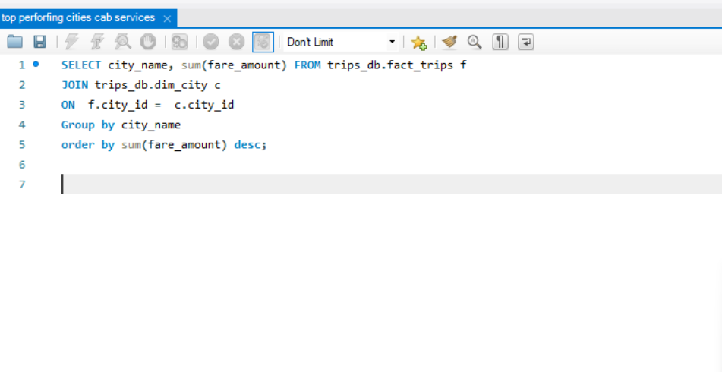
TOP PERFORMING CITIES

Slide 4
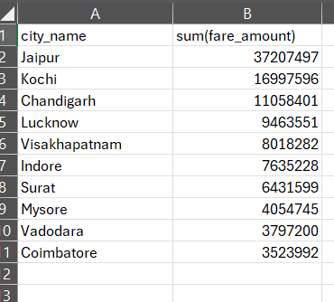
Top performing cities by Sum of fare amount

Slide 5
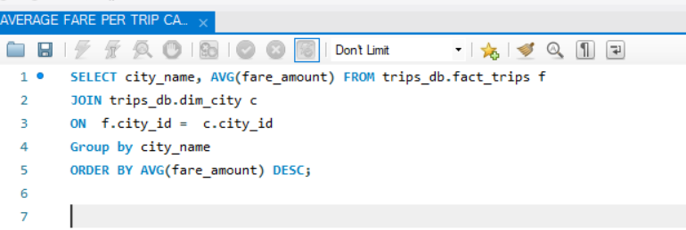
AVERAGE FARE PER TRIP DIFFERENT CITIES

Slide 6
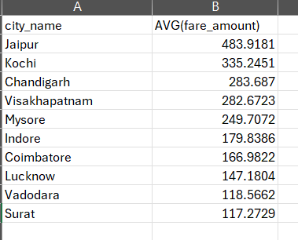
Average fare per trip different cities

Slide 7
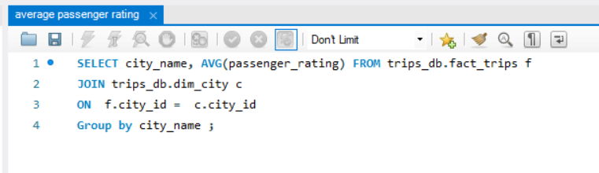
AVERAGE PASSENGER RATING

Slide 8
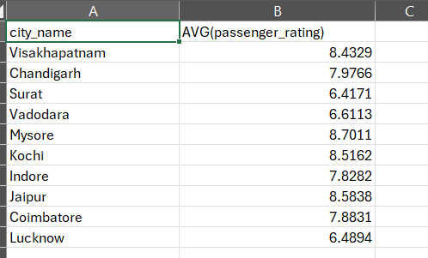
Average passenger rating

Slide 9
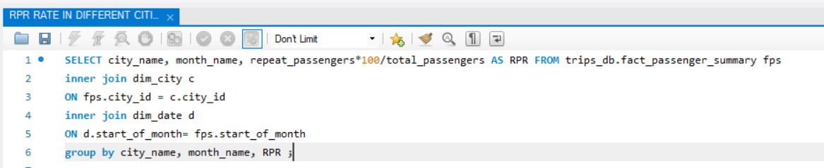
REPEAT PASSENGER RATAE RPR IN DIFFERENT CITIES IN DIFFERENT MONTHS

Slide 10
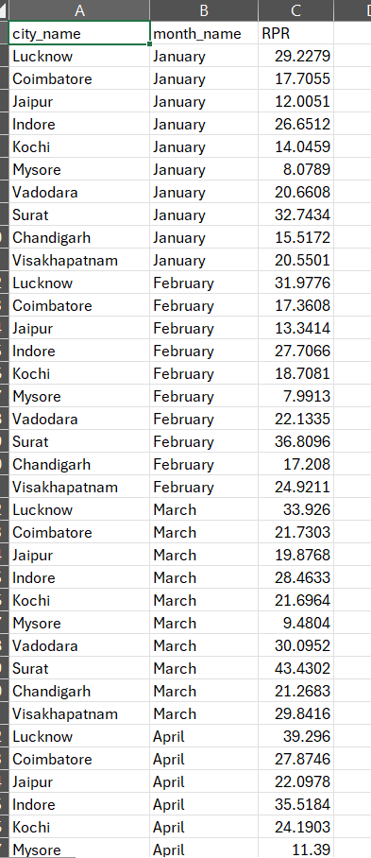
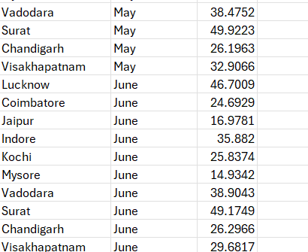
Percentage of repeat passenger rate RPR

Slide 11
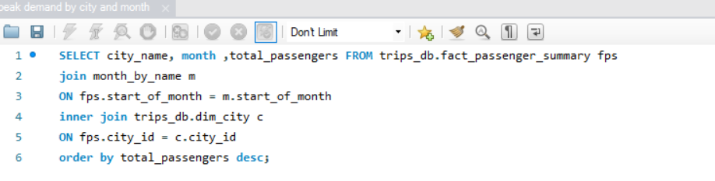
PEAK DEMAND OF PASSENGERS BY CITY AND MONTH

Slide 12
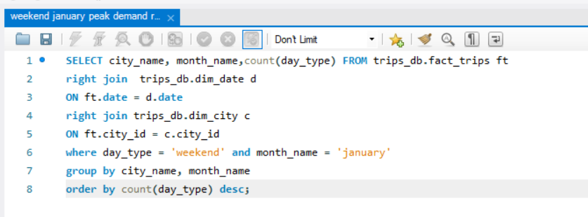
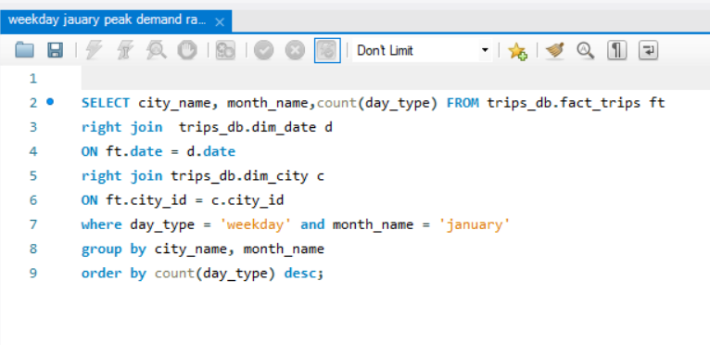
JANUARY WEEKDAY AND WEEKEND PEAK DEMAND RATE BASED ON No. OF PASSENGERS TRAVELLING

Slide 13
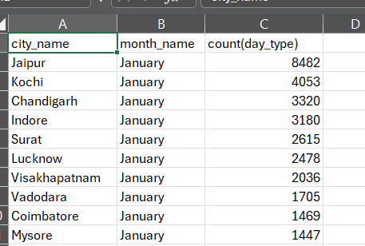
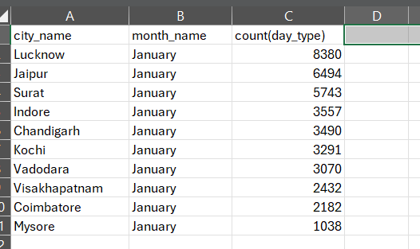
IN JANUARY WEEKDAY AND WEEKEND PEAK DEMAND RATES OF DIFFERENT CITIES BASED ON NO. OF PASSENGERS TRAVELLING

Slide 14
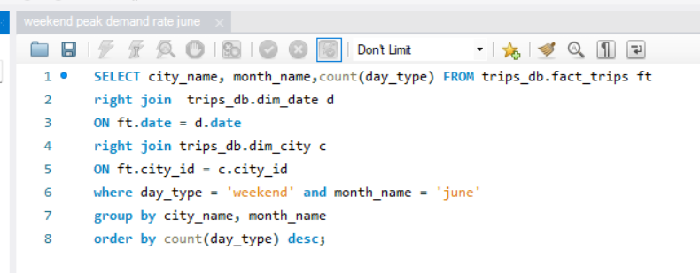
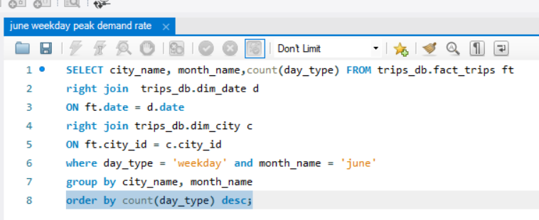
JUNE WEEKDAY AND WEEKEND PEAK DEMAND RATE BASED ON NO. OF PASSENGERS TRAVELLING

Slide 15
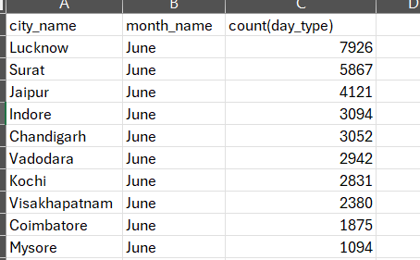
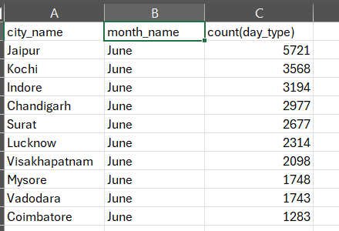
IN JUNE PEAK DEMAND RATES OF DIFFERENT CITIES BASED ON NO. OF PASSENGERS TRAVELLING

Slide 16
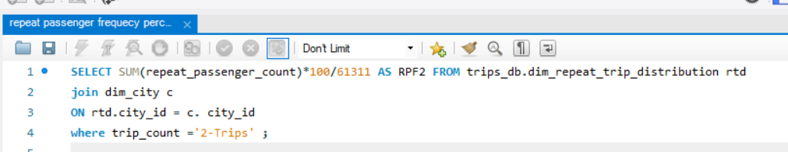
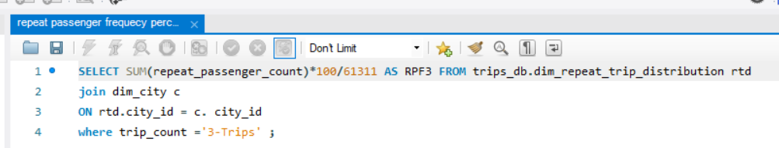
PERCENTAGE OF REPEAT PASSENGER FREQUENCY RPF2 FOR PASSENGERS TAKING ATLEAT 2- TRIPS;
RPF3 FOR PASSENGERS TAKING ATLEAST 3-TRIPS.

Slide 17
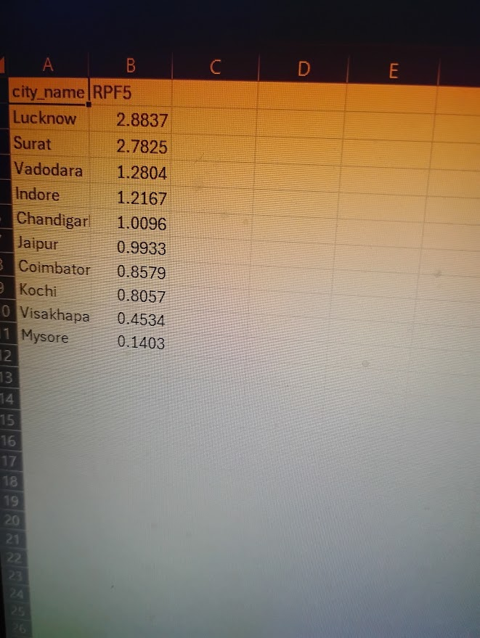
Repeat passenger frequency for passengers taking atleast 5 trips

Slide 18
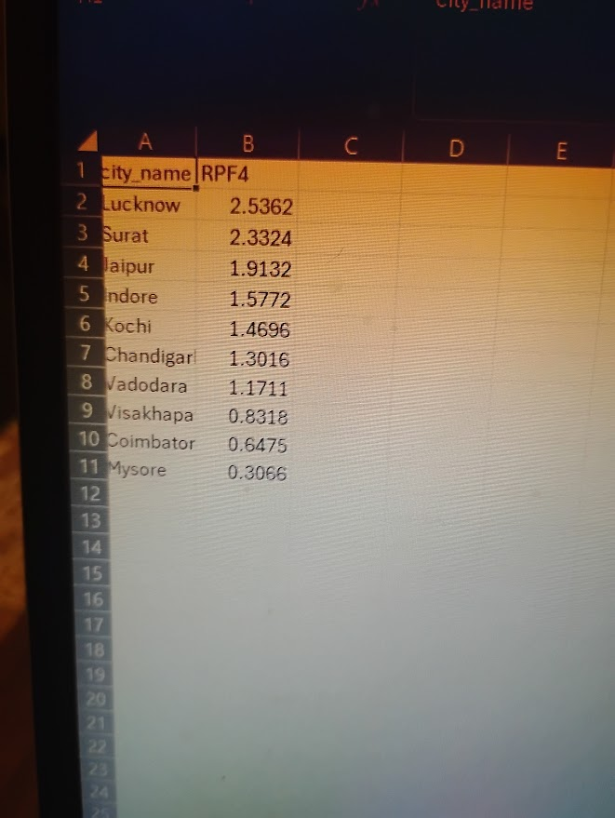
REPEAT PASSENGER FREQUENCY FOR PASSENGER TAKING ATLEAST 4 TRIPS , 6 TRIPS AS RPF4, RPF6

Slide 19
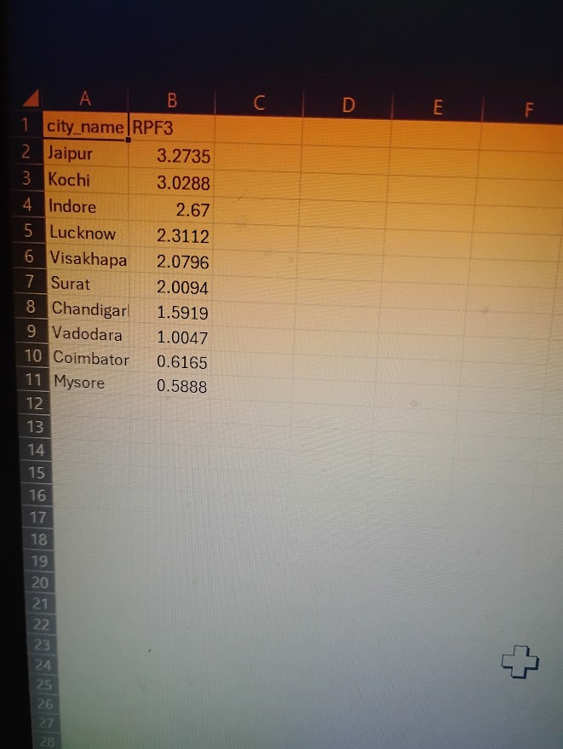
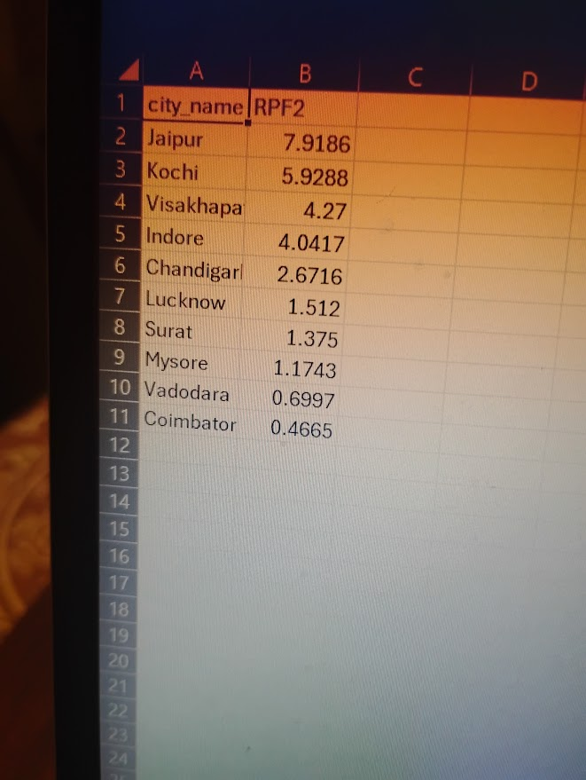
Repeat passenger frequencies for passengers taking atleast 2 trips,3 trips as RPF2, RPF3

Slide 20
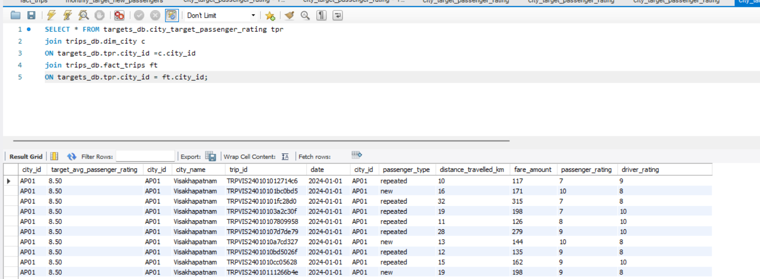
Comparing passenger rating with target passenger rating

Slide 21
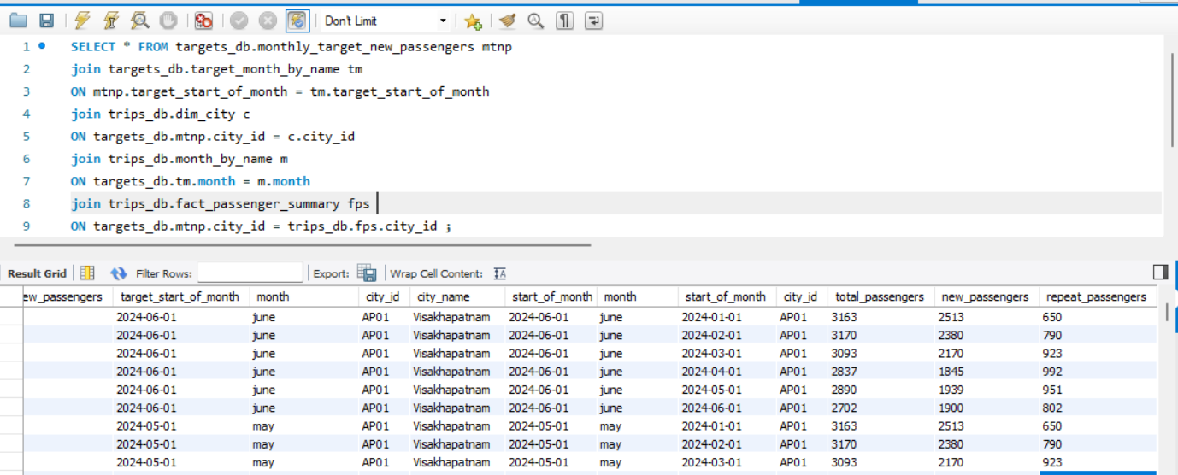
Combined table trips and target for analysis

Slide 22
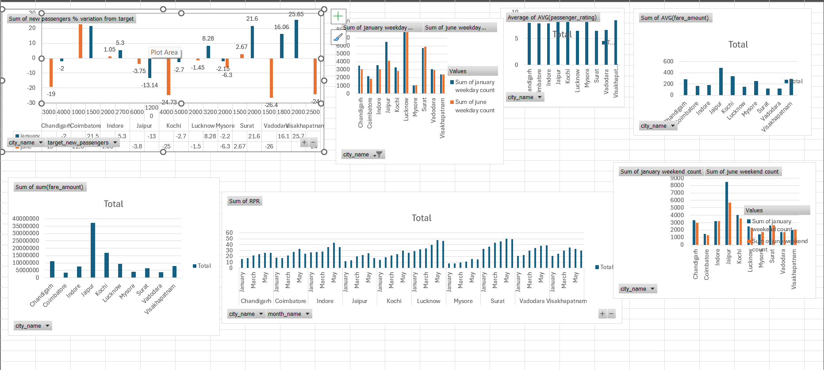
Dashboard Good cab services analysis

Slide 23
Conclusion:
On carefully doing sql data analysis and visual analysis :
Total amount of revenue and sum of fare collected is most from city of Jaipur followed by Kochi and least in Coimbatore ,Vadodara and Mysore.
From RPR chart it is observed repeat passenger rate for Coimbatore, Indore, Jaipur, kochi increased from January to May but decreased in June whereas for Lucknow and Mysore there is slight decrease in RPR rate in June, For Vadodara, Surat and Chandigarh may and June rate are near each other, For Visakhapatnam RPR rate most in April but start decreasing in May and June.
There is lot of variation in weekday Peak count of passengers travelling in Jaipur , there is decline in peak count of passengers in Jaipur in June than in January.There is decrease in weekday peak count in Chandigarh, Coimbatore, Indore, Kochi in June than in January and slight decrease in weekday peak count in Luchnow, Vadodara and Visakhapatnam whereas in surat there is slight increase in weekday peak count in June than in January.In mysore weekday peak count in June is near the weekday peak count in January.
There is lot of variation in weekend peak count of passengers travelling in Jaipur , there is decline in peak count of passengers travelling in June than in January.For Indore, Vadodara, Surat, Visakhapatnam,Lucknow weekend peak count is almost the same in June as in January, In chandigarh, Coimbatore, kochi there is slight decrease in weekend peak count where as in Mysore there is slight increase in weekend peak count passengers travelling based on no. of passengers travelling.
Average fare amount is most in the city of Jaipur followed by Kochi and least in Surat and Vadodara.

Slide 24
Conclusion:
Average passenger rating is most in Mysore followed by Jaipur and Kochi whereas least in Surat and Vadodara.
Comparing with target for new passengers there is increase in new passengers for Coimbatore, Indore, Surat both in January and June reaching above the target new passengers whereas target not achieved in chandigarh, Jaipur, kochi, Vadodara, Visakhapatnam in June whereas Lucknow, Mysore missed the target but near target benchmark.

